Slide 1
Lecture 01: Replace it!
This is a meaningful subtitle Dr. Gordon Wright

Slide 2
Show Attendance QR Code

Slide 3
Heading 1 - Section Head
This is a subtitle to the section header
Heading 2 - new slide title
Heading 2 copy
Heading 3 - italic emphasis
Spans for text accentuation - available in source mode
.shout accent3(red) 1.5em and Bold
.alert accent3(red) no change to font size
.fg .bg
.button accent1 whitetext button for link
.button-success
.takeaway
.highlight
Citations
Wright et al. (2012)
Cohen (1992) In text citation @Cohen1992
(Cohen, 1992) not in-text citation `(Cohen, 1992)
just type `@` and a search box comes up for your Zotero library or a .bib file associated with the project
Image|content 2 column
Slide with image and commentary in two columns and some explanatory text above
text text text text text text text text text text text text
text text text text text text text text text text text text

Slide 4
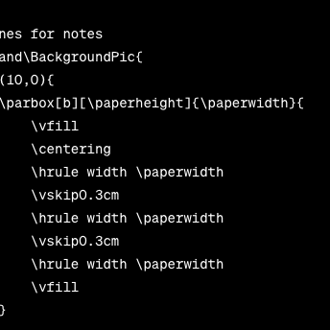
Here is some text
Bullet 1
Bullet 2
Bullet 3

Slide 5
input | output
{{< fa binoculars >}} | Prepare
{{< fa chalkboard-teacher >}} | Lecture
{{< fa users >}} | Lab
{{< fa bookmark >}} | Reading
{{< fa book >}} | Mini-Dissertation
Callouts
Note Callouts
Note default
content
Note simple
content
Note minimal
content
Icons by FontAwesome
These are cool but they do need a full render e.g. $ quarto render in order to be seen.
They can also be used in pdfs
Fontawesome

Slide 6
References
Cohen, J. (1992). A power primer. Psychological Bulletin, 112, 155–155. https://doi.org/10.1037/0033-2909.112.1.155
Wright, G. R. T., Berry, C. J., & Bird, G. (2012). “You can’t kid a kidder”: association between production and detection of deception in an interactive deception task. u1 - wright2012. Frontiers in Human Neuroscience, 6, 87. https://doi.org/10.3389/fnhum.2012.00087
Cohen, J. (1992). A power primer. Psychological Bulletin, 112, 155–155. https://doi.org/10.1037/0033-2909.112.1.155
Wright, G. R. T., Berry, C. J., & Bird, G. (2012). “You can’t kid a kidder”: association between production and detection of deception in an interactive deception task. u1 - wright2012. Frontiers in Human Neuroscience, 6, 87. https://doi.org/10.3389/fnhum.2012.00087

